Slide 1
Example PowerPoint Presentation

Slide 2
Slide 1
This is the first slide in the example presentation.

Slide 3
Slide 2
This is the second slide in the presentation.

Slide 4
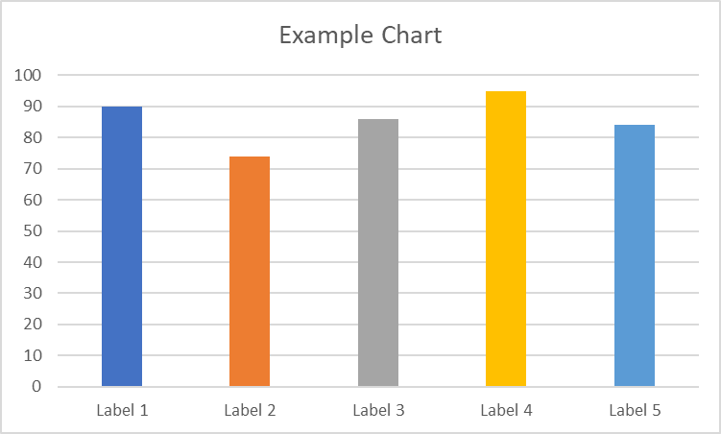
Slide 3

Slide 5
Thank You

